Slide 1


Slide 2

Designing & Implementing Hybrid Cloud Solutions
Important Disclaimer:
This session is not about Azure Pack, System Center and IaaS. Most of the content is related to Microsoft Azure Platform-as-a-Service. The target audience are solution architects and development leads. Code examples (C#) are part of it to demonstrate scenarios based on real-world projects.
CDP-B365
Mario Szpuszta
Principal Program Manager

Slide 3

Hybrid Cloud… … Cloud What!?

Slide 4
Hybrid Cloud outlined

Slide 5
Typical Hybrid Scenarios
Extend Infrastructure to the cloud
Data Processing in the cloud
Access data & apps in your data center
Integrate services from On-Premises
Processing across cloud & On-Premise

Slide 6
Approaches to Hybrid Cloud
Infrastructure extension
Data-sync and linking
Service-Relay Proxies
Messaging to/from On-Premise
Technology-specific approaches

Slide 7
Why Hybrid Cloud?
Your IT can benefit from public cloud
Pay-per-use, scalability, elasticity
You cannot move all to a public cloud
Existing investments, legal constraints etc.
Hybrid = best of both
Run in public cloud and your own data center

Slide 8

Sounds Complex? Learn from real-world solutions

Slide 9
Infrastructure Extensions to the Cloud Azure VNET, Site-2-Site VPN, Point-2-Site VPN

Slide 10
Infrastructure Extensions to the Cloud
Advantages:
No development effort required
Easy to setup and get running
Disadvantages:
No additional semantics and extensions
Latency through VPN
Limits on additional semantics and logic

Slide 11
Data-Sync and Linking for Hybrid Cloud Azure SQL Data Sync & SQL Linked Servers

Slide 12
Data-Sync and Linking for Hybrid Cloud Azure SQL Data Sync & SQL Linked Servers

Slide 13
Data-Sync and Linking for Hybrid Cloud
Advantages:
Development effort depends on scenario
Easy to setup and get running
Disadvantages:
Limits on additional semantics & logic
Development effort depends on scenario
Data-Sync – Limited data types, schedules & in preview
Linked Servers – one direction (to Azure) & latency

Slide 14
Hybrid Cloud with Service-Relay Adapters Azure Service Bus Relay

Slide 15



Hybrid Cloud with Service-Relay Adapters BizTalk Hybrid Connections
Corporate Network
Microsoft SQL Server
Web Sites
Other published resources
Hybrid Connection
Hybrid Connection Manager
Mobile Services

Slide 16
Hybrid Cloud with Service-Relay Adapters
Advantages
Allows for custom connectivity semantics
No heavy infrastructure IT requirements
e.g., Firewall port openings, NAT, proxies
Disadvantages
Relay – Custom development effort
Relay – works best with .NET, only
BizTalk Hybrid – Only for Websites & Mobile Services
Both – Latency, availability, “hick-ups” of relay connections
Both – Non-Traditional On-premise scale-out / failover

Slide 17
Messaging to/from On-Premise Services Azure Service Bus Topics, Queues

Slide 18
Messaging to/from On-Premise Services
Advantages
Asynchronous processing
Reliability (due to persistent nature of queues)
Better scalability (load balancing / load leveling in nature)
Disadvantages
Complexity of asynchronous processing
Bigger development & architecting effort
Might not fit for every use case

Slide 19

Does that perform?

Slide 20

Scenario & Interface Designs Matters
There is no Silver Bullet
Hybrid does not work for every scenario, but everyone should consider it as option
Some interface designs work better than others
E.g. chatty vs. Chunky
Some usage patterns work better than others
E.g. 1000s of calls / second vs. 100s of calls

Slide 21
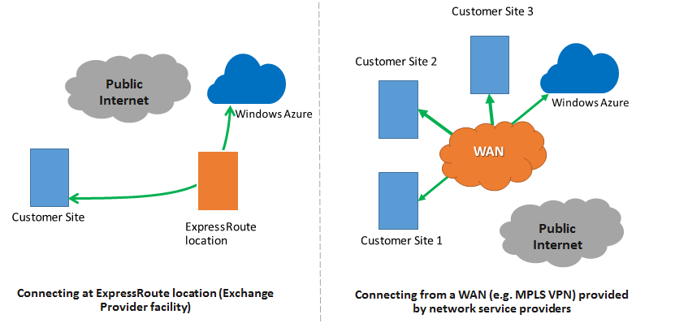
Improving connectivity with ExpressRoute
Two types of connectivity
Through exchange provider facilities
Via network service providers
Supported providers
Equinix, Level 3
AT&T, Level3 MPLS VPN
British Telekom
…

Slide 22

How do I manage both?

Slide 23
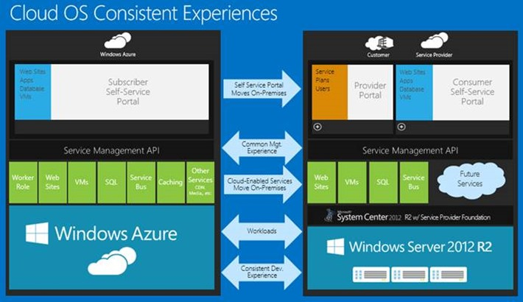
Operations of a Hybrid Cloud Solution
Azure Service Management and monitoring API
Enables integrating Azure monitoring data into ANY monitoring solution
Microsoft’s solution: System Center 2012 R2
Ops Manager and App Controller and Orchestrator
Azure management packs (Azure core, SQL DB)
Azure integration pack for orchestrator
Unified VM provisioning and operations across
Microsoft Azure/public cloud
On-Premise/private cloud (Hyper-V + VMWare)
3rd-party hosters (especially with Azure Pack)

Slide 24

Authentication & SSO!?

Slide 25
Identity & Authentication
Azure Active Directory
User/organization/application management
Your directory in the cloud
Synchronization with on-premises possible
Simple: using same identities across premises
Advanced: single-sign-on across On-Premise and Cloud
Some neat side-effects
Applications get user management “for free”
Azure AD can bridge towards “open authentication standards”

Slide 26
Summary QandA, Resources

Slide 27
Hybrid and Microsoft Azure technologies
 | Directly relevant azure services | Cross cutting concerns
 |  | Identity and access | Connectivity (optional) | Operations (optional)
Infrastructure-driven | Virtual network Site-2-site VPN Point-2-site VPN VM endpoint acls | Microsoft Azure Active Directory and Access Control | Azure express route | Azure Service Management and monitoring APIS System Center, any 3rd-party tools
Data-driven | Azure SQL linked servers SQL always-on (Azure SQL data sync) Storsimple appliance
Service oriented | Service bus relay
Messaging oriented | Service bus queues and AMQP Service bus topics (Azure queues)
Service usage-driven | Any Azure-Service, e.g. HDInsight, scheduler etc.
Technology-specific | Microsoft HPC Pack Cassandra multi-dc setup Mongodb multi-dc setup ... | Any technology-specific approach offered by the platform of choice

Slide 28
What we built as part of our demos…

Slide 29

Resources
Azure Virtual Network and VPN
http://www.windowsazure.com/en-us/documentation/services/virtual-network/
http://msdn.microsoft.com/en-us/library/windowsazure/jj156007.aspx
http://msdn.microsoft.com/en-us/library/windowsazure/jj156075.aspx (!!)
Azure Service Bus
http://www.windowsazure.com/en-us/documentation/articles/service-bus-dotnet-how-to-use-relay/
http://www.windowsazure.com/en-us/documentation/articles/service-bus-dotnet-how-to-use-queues/
http://www.windowsazure.com/en-us/documentation/articles/service-bus-dotnet-how-to-use-topics-subscriptions/
http://www.windowsazure.com/en-us/documentation/articles/service-bus-dotnet-advanced-message-queuing/
http://msdn.microsoft.com/en-us/library/windowsazure/hh532261.aspx (!!)
Azure Active Directory
http://www.windowsazure.com/en-us/services/active-directory/
http://technet.microsoft.com/en-us/library/jj573653.aspx
http://msdn.microsoft.com/en-us/library/windowsazure/dn151121.aspx
http://msdn.microsoft.com/en-us/library/windowsazure/dn532272.aspx
ExpressRoute
http://www.windowsazure.com/en-us/services/expressroute/
http://msdn.microsoft.com/en-us/library/windowsazure/dn606309.aspx
System Center 2012 R2
http://www.microsoft.com/en-us/download/details.aspx?id=38414
http://technet.microsoft.com/en-us/library/gg276383.aspx
http://technet.microsoft.com/de-de/library/jj721956.aspx
http://blogs.technet.com/b/server-cloud/archive/2011/12/01/managing-and-monitoring-windows-azure-applications-with-system-center-2012.aspx
http://blogs.technet.com/b/configmgrteam/archive/2013/10/23/configmgr-and-endpoint-protection-support-for-windows-azure-vms.aspx
My blog
http://blog.mszcool.com
Hybrid Cloud on Technet
http://blogs.technet.com/b/in_the_cloud/archive/tags/hybrid+cloud/default.aspx

Slide 30

Resources
Learning
Sessions on Demand
Microsoft Certification & Training Resources
http://channel9.msdn.com/Events/TechEd
www.microsoft.com/learning
TechNet
Developer Network
Resources for IT Professionals
http://microsoft.com/technet
http://developer.microsoft.com

Slide 31

For more information
Windows Server
Windows Server Technical Preview
http://technet.microsoft.com/library/dn765472.aspx
System Center
System Center Technical Preview
http://technet.microsoft.com/en-us/library/hh546785.aspx
Azure Pack
Azure Pack
http://www.microsoft.com/en-us/server-cloud/products/ windows-azure-pack
Microsoft Azure
Microsoft Azure
http://azure.microsoft.com/en-us/
Come visit us in the Microsoft Solutions Experience (MSE)!
Look for the Cloud and Datacenter Platform area TechExpo Hall 7

Slide 32


Azure
Exams
Developing Microsoft Azure Solutions
EXAM
532
Implementing Microsoft Azure Infrastructure Solutions
EXAM
533
(Coming soon)
Architecting Microsoft Azure Solutions
EXAM
534
http://bit.ly/ Azure-Cert
+
Classroom
training
(Coming soon)
Microsoft Azure Fundamentals
MOC
10979
Developing Microsoft Azure Solutions
MOC
20532
Implementing Microsoft Azure Infrastructure Solutions
2
5
MOC
20533
5
http://bit.ly/ Azure-Train
Online
training
(Coming soon)
Microsoft Azure Fundamentals
MVA
(Coming soon)
Architecting Microsoft Azure Solutions
MVA
http://bit.ly/ Azure-MVA
Get certified for 1/2 the price at TechEd Europe 2014!
http://bit.ly/ TechEd-CertDeal

Slide 33
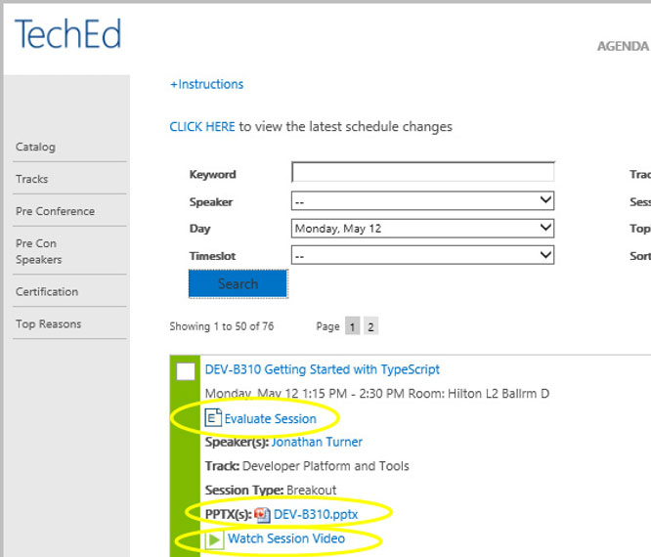
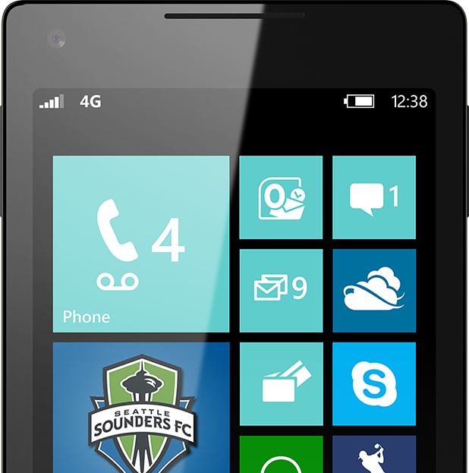

Please Complete An Evaluation Form Your input is important!
TechEd Schedule Builder
CommNet station or PC
TechEd Mobile app
Phone or Tablet
QR code

Slide 34
Evaluate this session

Slide 35


© 2014 Microsoft Corporation. All rights reserved. Microsoft, Windows, and other product names are or may be registered trademarks and/or trademarks in the U.S. and/or other countries.
The information herein is for informational purposes only and represents the current view of Microsoft Corporation as of the date of this presentation. Because Microsoft must respond to changing market conditions, it should not be interpreted to be a commitment on the part of Microsoft, and Microsoft cannot guarantee the accuracy of any information provided after the date of this presentation. MICROSOFT MAKES NO WARRANTIES, EXPRESS, IMPLIED OR STATUTORY, AS TO THE INFORMATION IN THIS PRESENTATION.

